Slide 1
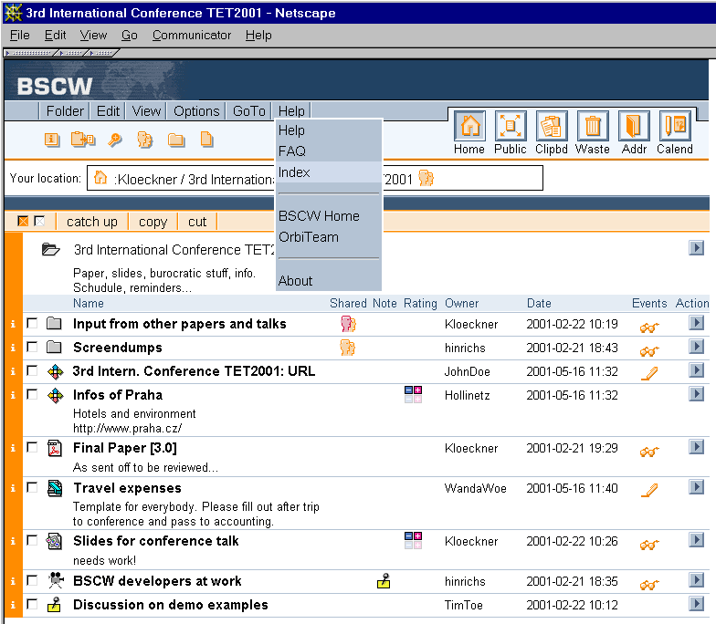
Business Collaboration Showcase

Slide 2
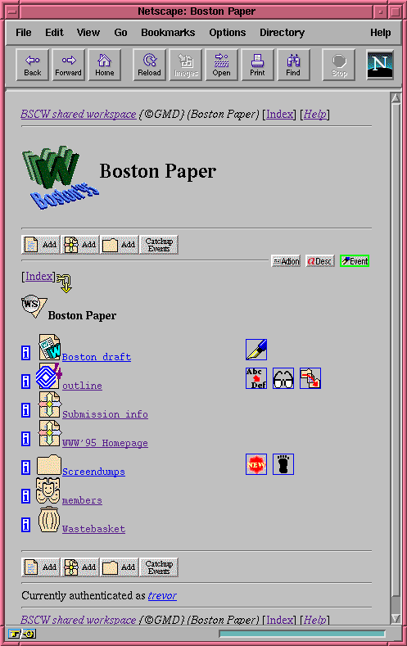
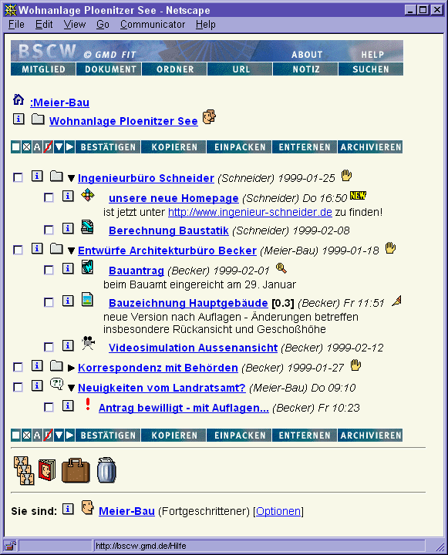

Business Collaboration Showcase

Slide 3
Patterns of BSCW Usage
Project management
Organisation and department management
Ad hoc group information exchanges
Communities
Individual storage

Slide 4
Shortcomings
Single server approach
Distribution only on NFS level
Service Level determined by server installation applies for all supported workspaces
…

Slide 5
Basic Architecture
CGI
CGI
CGI
Database
Process
Metadata
Content

Slide 6


New Architecture
CGI
CGI
CGI
Database
Process
Metadata
WP6 SOA Layer

Slide 7

New Architecture
CGI
CGI
CGI
Database
Process
Metadata
WP6 SOA Layer

Slide 8
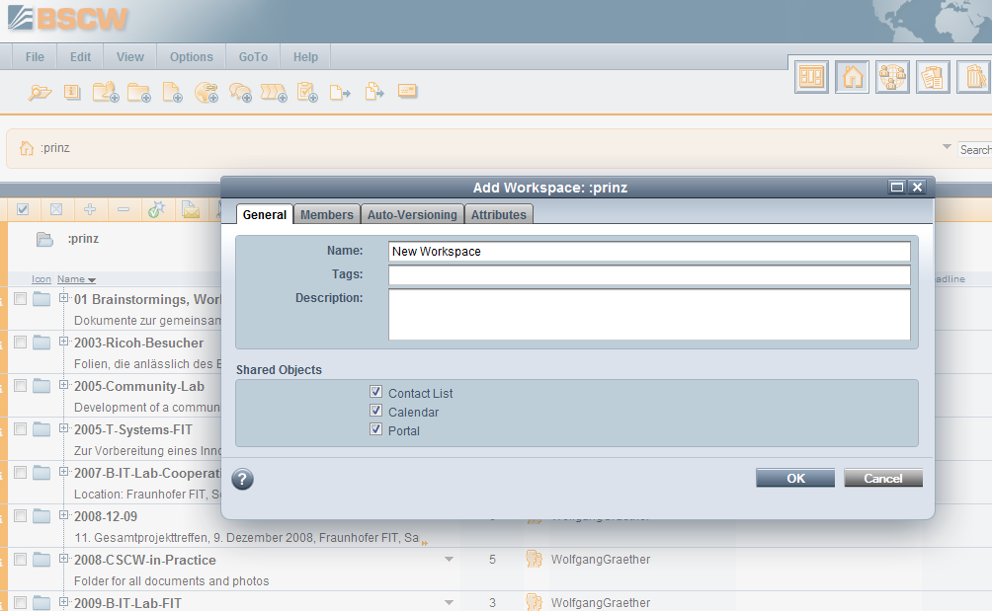
Semantics
Location (national, international)
Speed, Performance
Encryption
BackUp
Reliability
Mobility
Clustering
By workspace
By folder
By document
By user
By process / scenario

Slide 10
CLOUD

Slide 11
CLOUD
Location (national, international)
Speed, Performance
Encryption
BackUp
Reliability
Mobility

Slide 12
Is that possible?
CGI
CGI
CGI
Database
Process
Metadata
Content

Slide 13
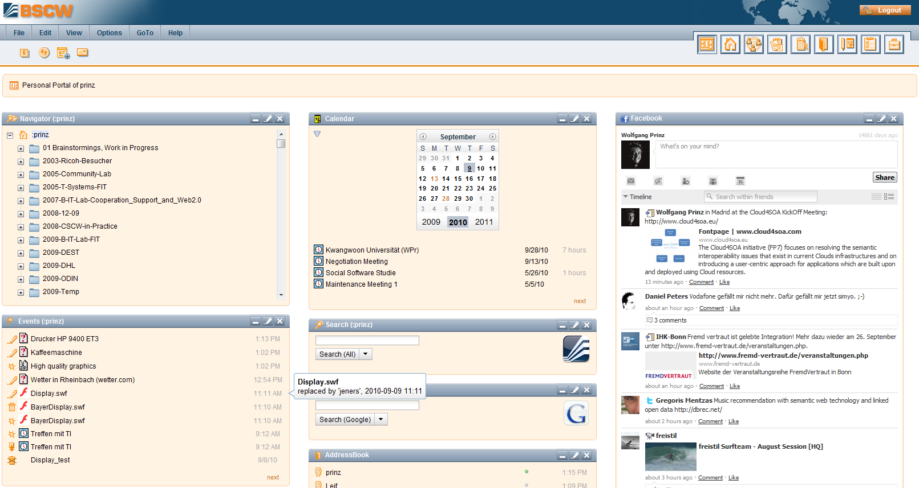
BSCW User Portal
Integration of Cloud4SOA Widgets for:
Semantic Management of clouded workspaces?
Reorganisation of clouded workspaces?
…

Slide 14
Challenging Issues
Cross Server use of cloud content
Cross Plattform use of cloud content
Cross Plattform interoperability by cloud interoperability

